Slide 1
DSLS 2023 Mini Project DS: Case Study
Hendri Darmawan
hendridarmawan512@gmail.com

Slide 2
Business Understanding
Problem Statement: Traffic jams occur due to recurring and non-recurring factors such as a lack of enough road capacity, accidents, construction zones, and inclement weather conditions. Traffic jams can lead to significant economic costs and air quality problems in cities.
Modelling Proposed Solution: Clustering traffic at different times of the day, namely morning, afternoon, evening, and night, to identify clusters problably can help stakeholders create solutions with the same solutions in the same cluster.

Slide 3

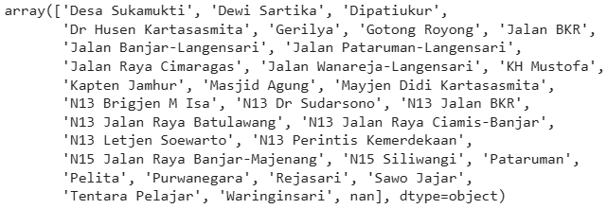
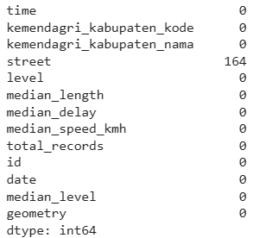
Data Understanding
Street consists of 31+1 (NaN) different places
There are some missing values on street columns

Slide 4
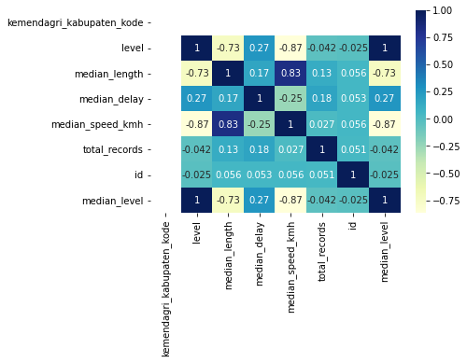
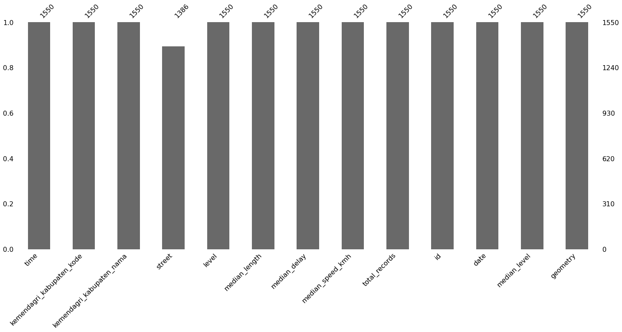
Data Cleansing and Preprocessing
Missing Values
Spearman Correlation

Slide 5
Classification Model using k-NN and XGBoost

Slide 6
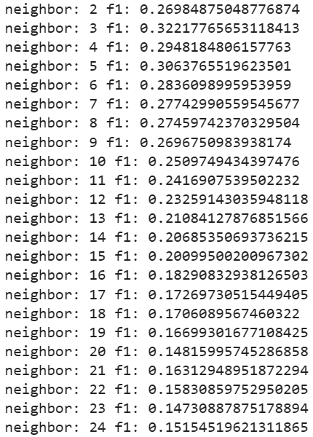

Baseline Classification Model for Interpolation Using F1 Score
Baseline model using k-Nearest Neighbor Tuning k values
Baseline model using XGBoost Classifier without Tuning

Slide 7
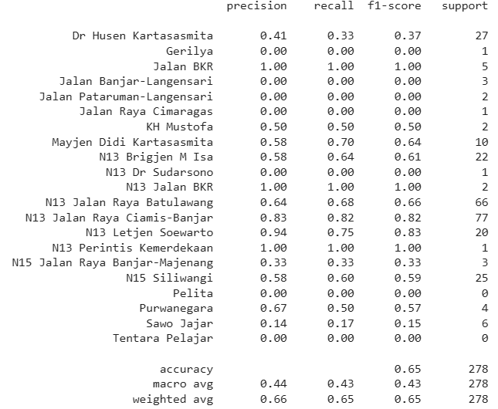
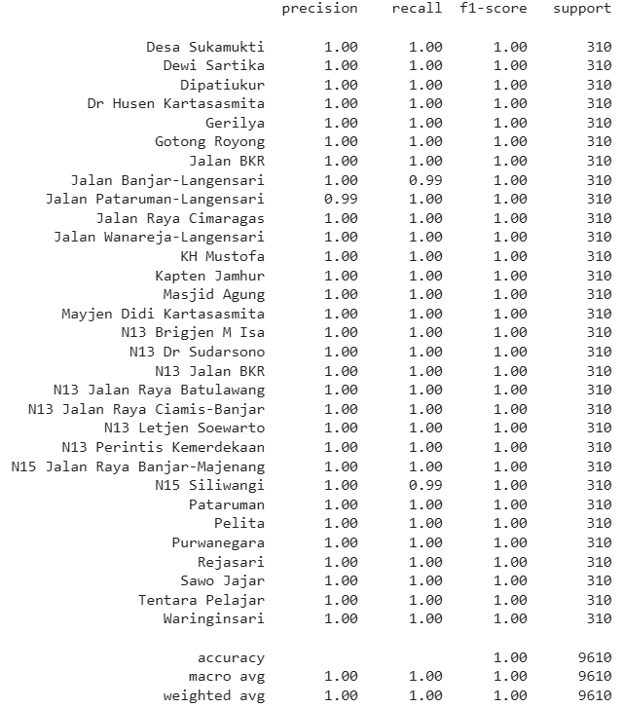
Classification Model for Interpolation Using XGBoost
Model using XGBoost Classifier Tuned using Bayesian Optimization
Testing Set Classification Report
Training Set Classification Report

Slide 8
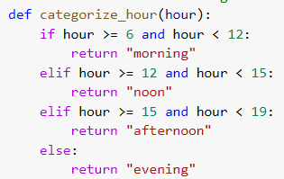
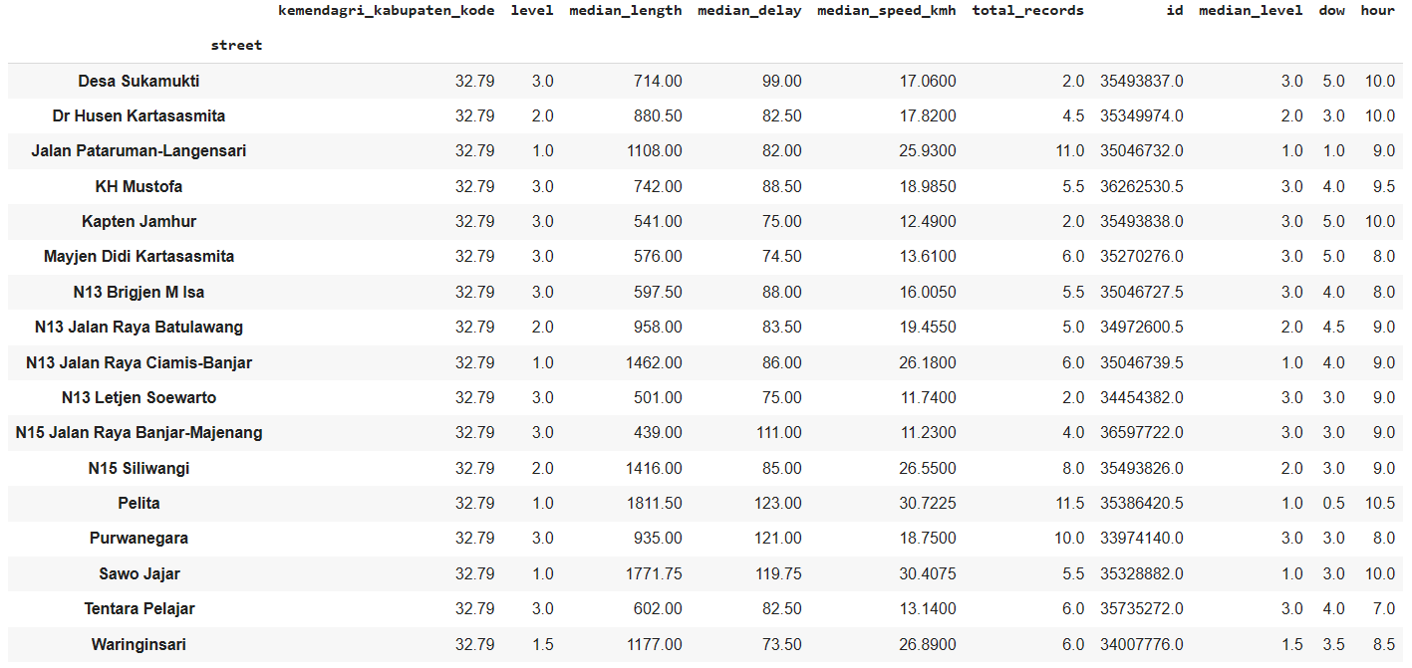
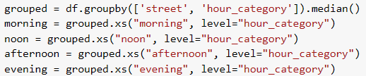
Grouping Street into 4 Different Times
Function
Example morning dataset
Aggregate the data by using median values in each columns to get the generalization of each street reharding the measurement data. Median is used to avoid the outlier impact

Slide 9
Clustering Model using K-Means Algorithm

Slide 10
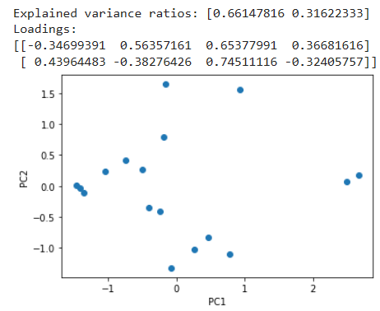
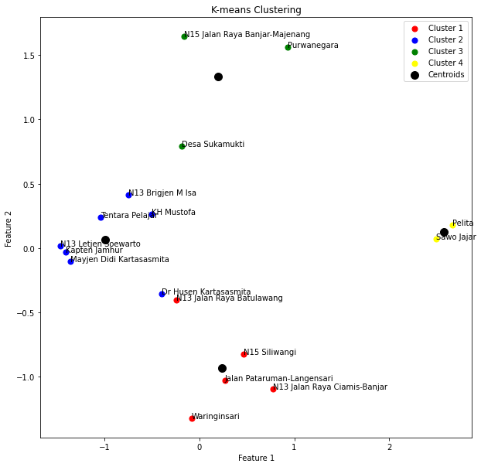
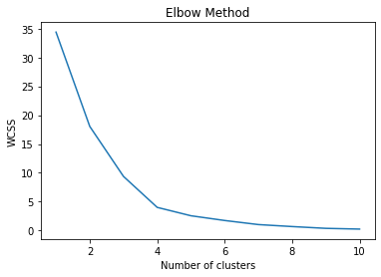
Clustering [Morning]
Morning time can be divided into 4 clusters based on Elbow method. Stakeholder can analyze based on cluster belong to every street.

Slide 11
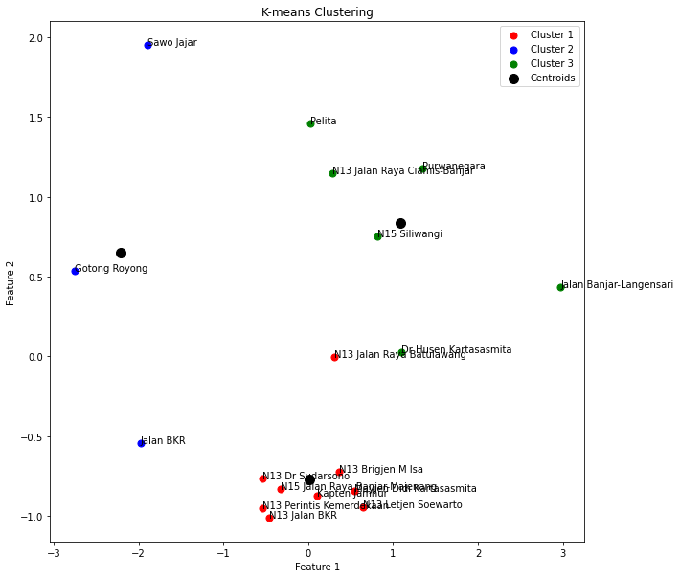
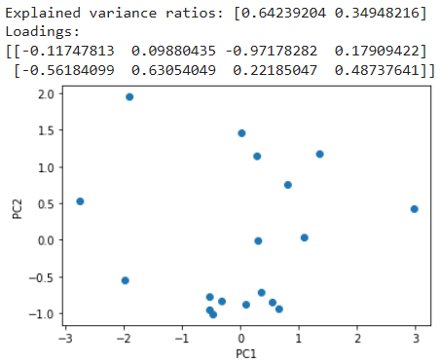
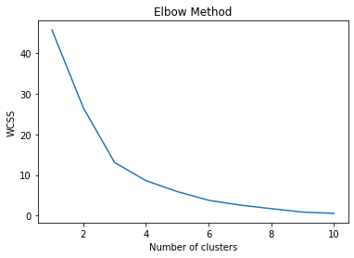
Clustering [Noon]
Noon time can be divided into 3 clusters based on Elbow method. Stakeholder can analyze based on cluster belong to every street.

Slide 12
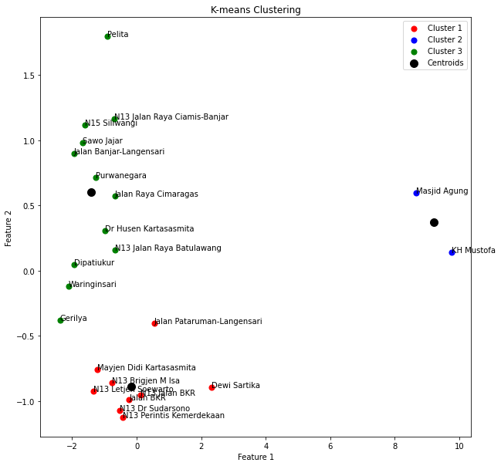
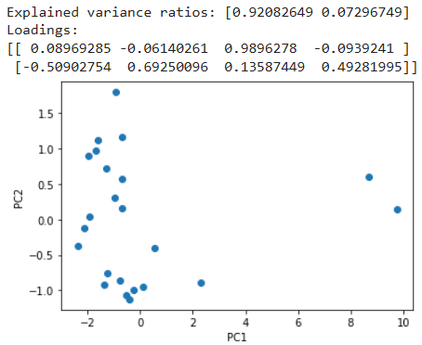
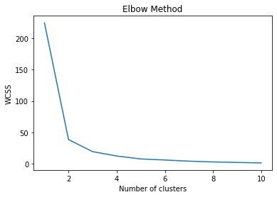
Clustering [Afternoon]
Afternoon time can be divided into 3 clusters based on Elbow method. Stakeholder can analyze based on cluster belong to every street.

Slide 13
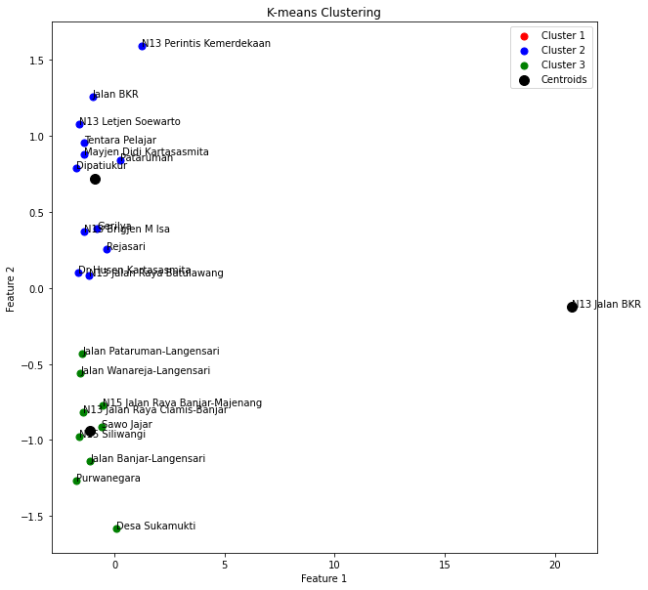
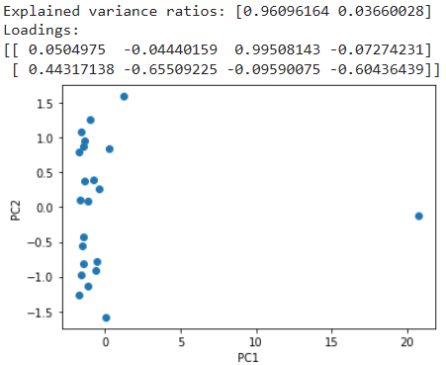
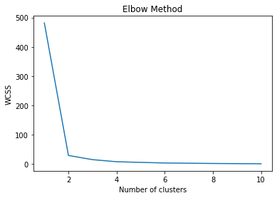
Clustering [Evening]
Evening time can be divided into 3 clusters based on Elbow method. Stakeholder can analyze based on cluster belong to every street.

Slide 14
References
https://towardsdatascience.com/visualizing-missing-values-in-python-is-shockingly-easy-56ed5bc2e7ea
https://en.wikipedia.org/wiki/Spearman%27s_rank_correlation_coefficient
https://www.ibm.com/id-en/topics/knn#:~:text=What%20is%20the%20k%2Dnearest%20neighbors%20algorithm%3F,-Learn%20about%20the&text=The%20k%2Dnearest%20neighbors%20algorithm%2C%20also%20known%20as%20KNN%20or,of%20an%20individual%20data%20point.
https://towardsdatascience.com/beginners-guide-to-xgboost-for-classification-problems-50f75aac5390
https://medium.com/analytics-vidhya/hyperparameter-tuning-hyperopt-bayesian-optimization-for-xgboost-and-neural-network-8aedf278a1c9

Slide 15
Thank You

